Slide 1


CANoe TMP implementation
More Lives Saved
More Life Lived
Victor Ursache
SWV

Slide 2
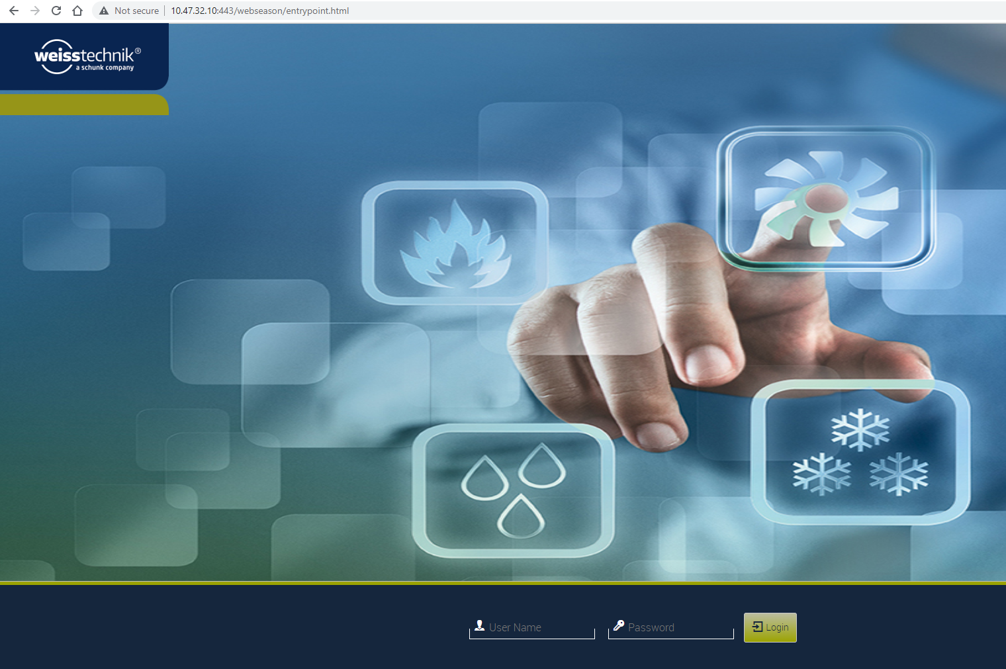
1. WeissTechnik Thermal Chamber: Ethernet Interface
1
This user interface lets you use any PC to monitor the status of chambers via an intranet or Internet connection without needing to install any other software (e.g. S!MPATI®), but the interface is only available in English.
To use this interface, you need to enter the Thermal Chamber IP address, which is: 10.47.32.10. (as it is shown by Attention: the PORT is not needed. It is selected automatically as 443).
To login in this interface you need previously to create a USER and a PASSWORD using the TMP HMI, but we will use as user: vur, and as password: 12345. (in location pointed with ).
1
2
2

Slide 3
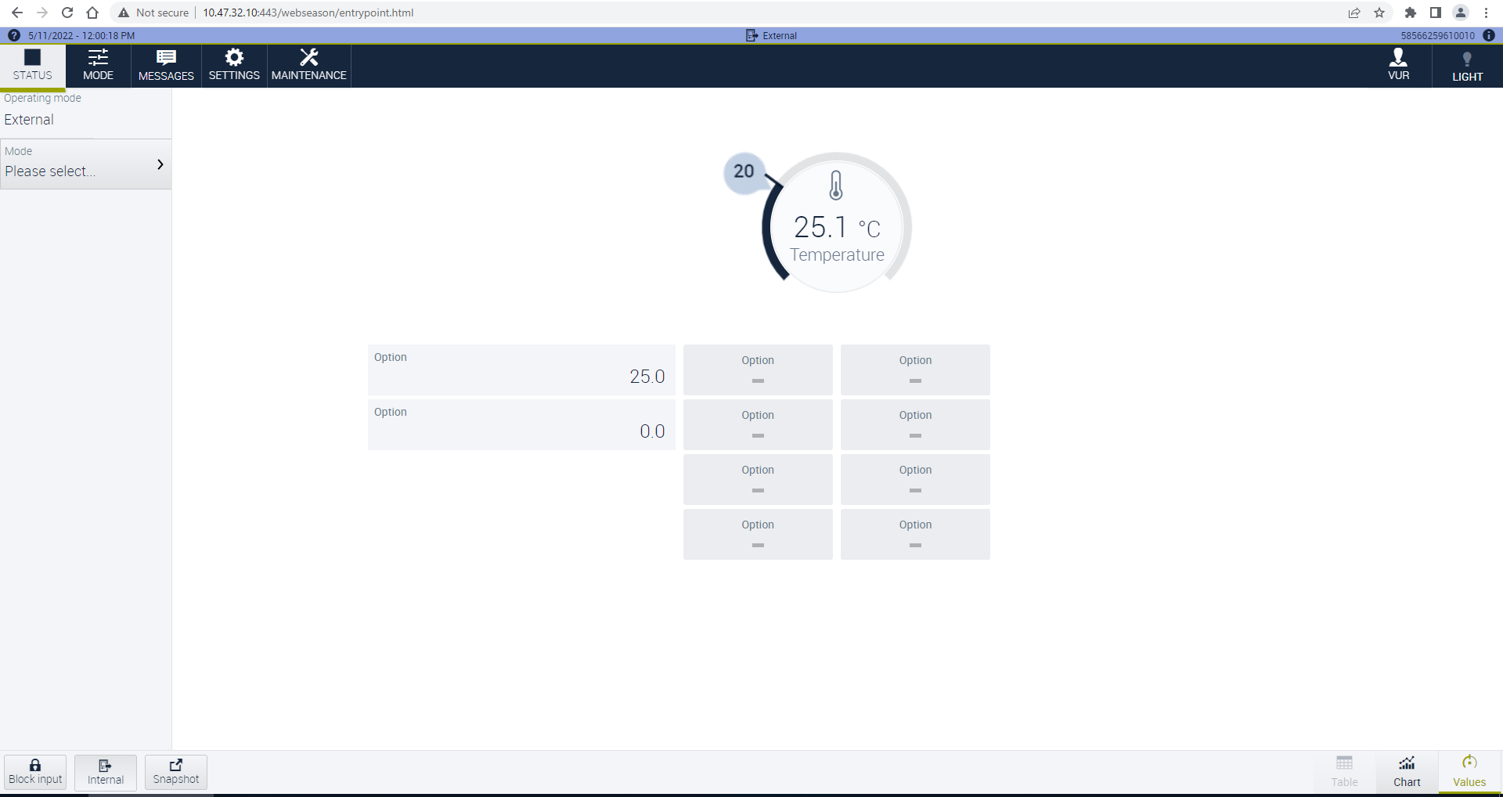
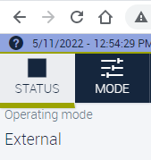
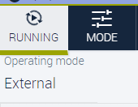
6
7
3
After ‘login’, the interface will be available as in side image.
is showing us selected operating mode, as it is showed also by (only if ‘External’ mode is selected from ).
If we want to control the TMP using ARIA or CANoe, we need to select it as External.
Arrow is indicating the selected setpoint: 20 ℃, and the actual temperature that is 25.1℃.
Arrow is indicating the button used to ON/OFF the light from TMP.
Also, the is indicating the status of TMP:
stopped;
running.
5
3
6
4
5
7
3
4

Slide 4
2. Needed files:
2.1 TCargs.pyw && TCPThermalChamber.py → Functions for TCP/IP communication with TMP
2.2 ThermalChamberControl.cin → Functions for CAPL scripts
2.3 ThermChamber.vsysvar → System variables
2.4 ThermalChamberPanelControl.can && ThermalChamberNode.can → Panel control functions / event (button) handlers
2.5 ThermalChamberPanel.xvp → Panel interface
2.6 sTCMeasureFile.txt → TMP output file
PTC location: e:/MKSProjects/SWVR_PP_CI_Activities/CANOE_TEST_PLATFORM/Includes/HW_Modules/TMP/
Implemented and tested on : CANoe Build 15.4.35 (SP4) – 64 bit

Slide 5
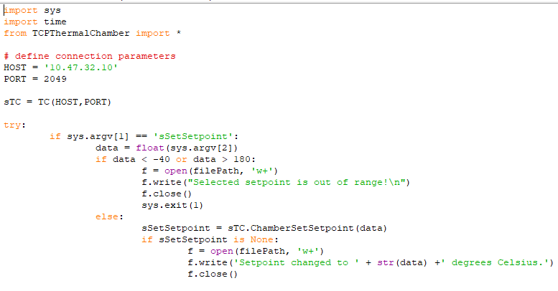
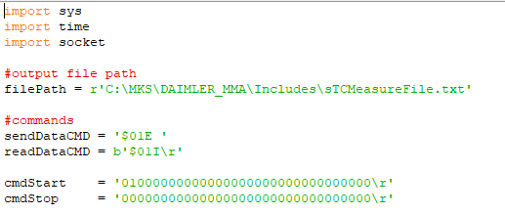
2.1 TCargs.pyw && TCPThermalChamber.py
TCargs.pyw: HOST and PORT should be updated if they were changed;
TCPThermalChamber.py: filePath should be updated with the path where you have/want the file;
1
2

Slide 6
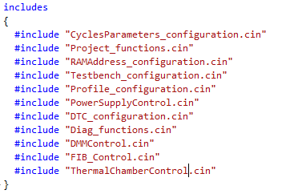
2.2 ThermalChamberControl.cin
If you wish to access TMP functionality through CAPL scripts, this must be included, otherwise skip this step.
E.g., for DAIMLER MMA:

Slide 7
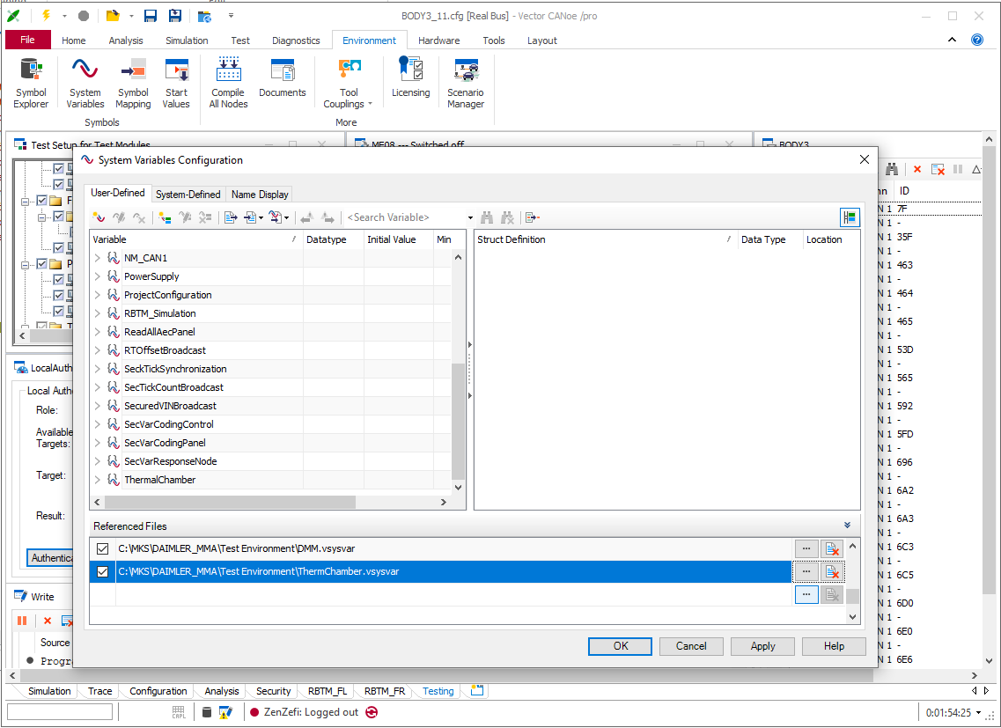
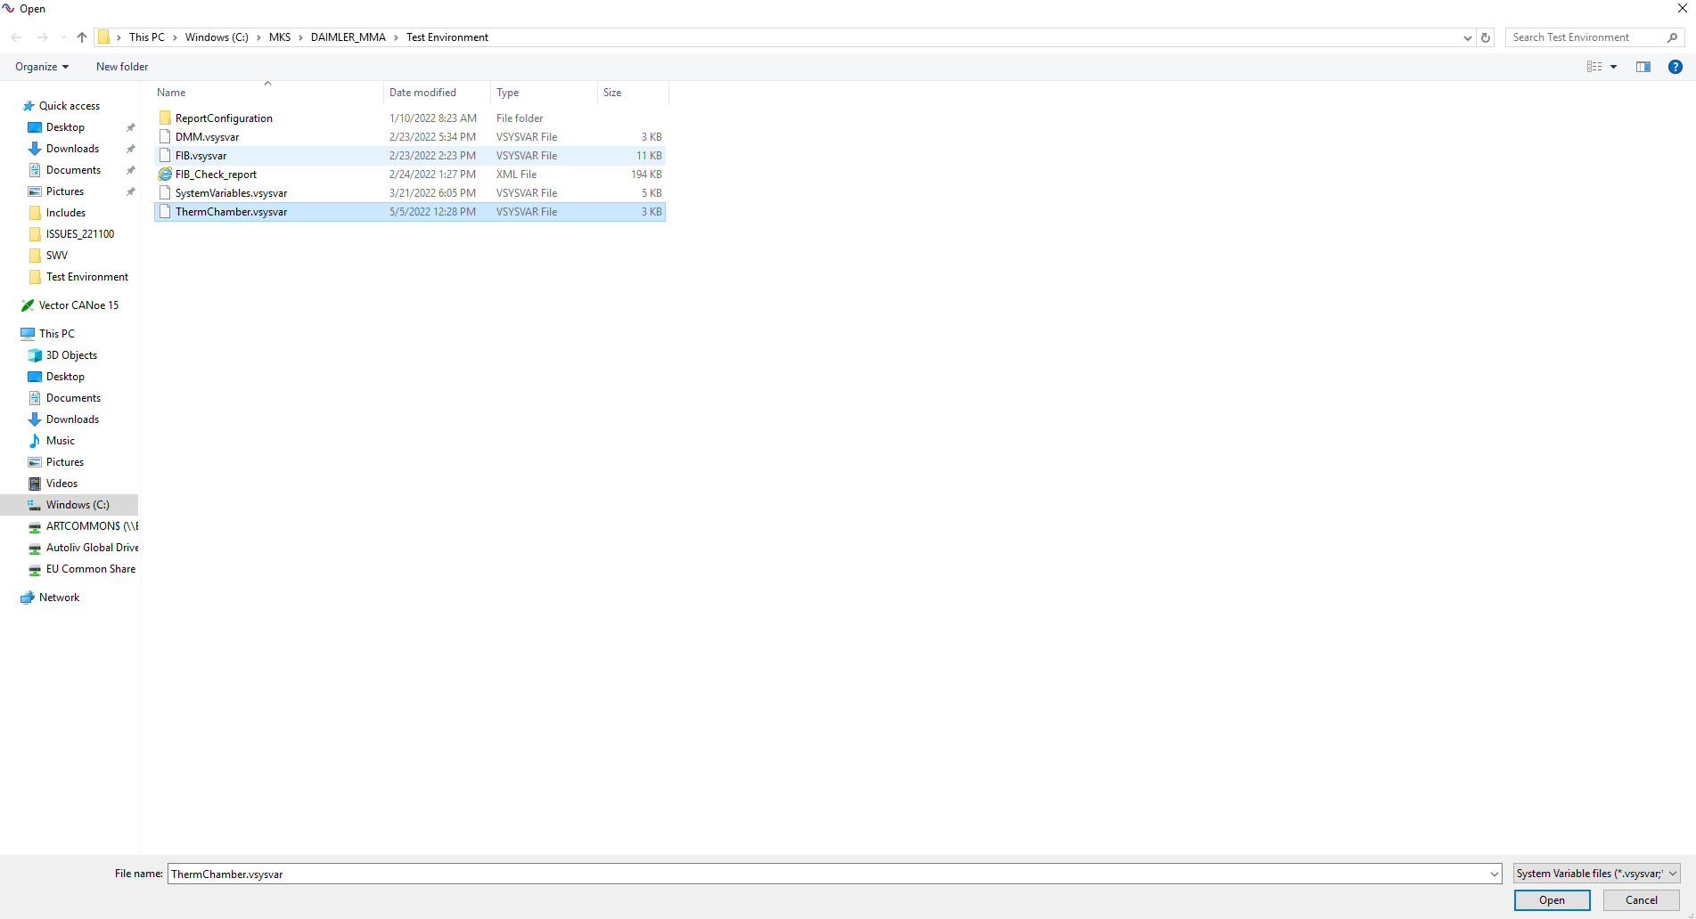
2.3 ThermChamber.vsysvar
Import to CANoe configuration: Environment → System Variables → Select File → Open → Apply → OK
Also, be sure that checkbox from is checked.
1
2
4
*
5
3
7
6
*

Slide 8
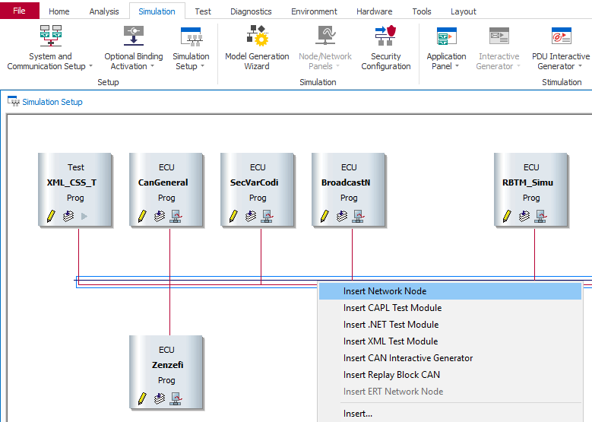
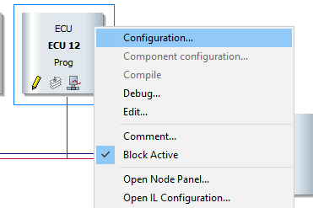
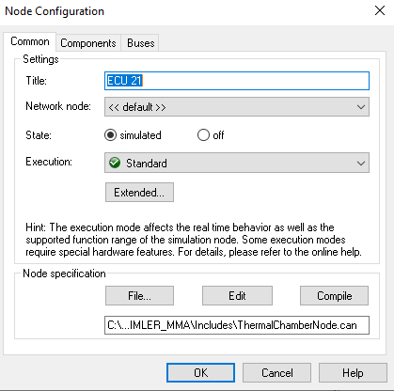
2.4 ThermalChamberNode.can
Add to CANoe:
Simulation → Simulation Setup → Right click on BUS → Insert Network Node
Right click the new generated node → Configuration → File → Open ThermalChamberNode.can
1
2
4
3
5

Slide 9
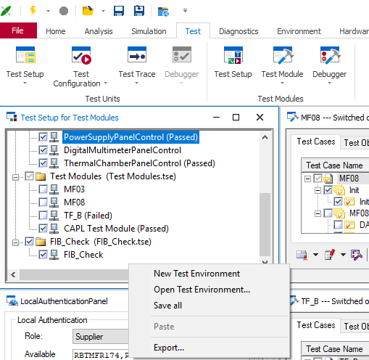
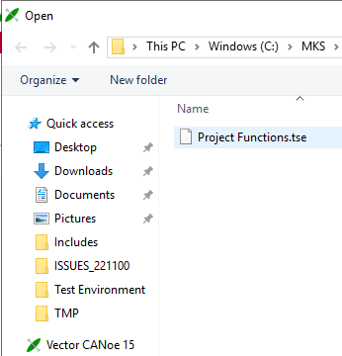
2.4 ThermalChamberPanelControl.can
Add to CANoe:
Test→ Test Setup → Right click on the bottom of Test Setup for Test Modules → Open Test Environment → Project Functions.tse (pay attention: this *.tse file will add also other features like DMM or PowerSupply);
1
2
4
3

Slide 10
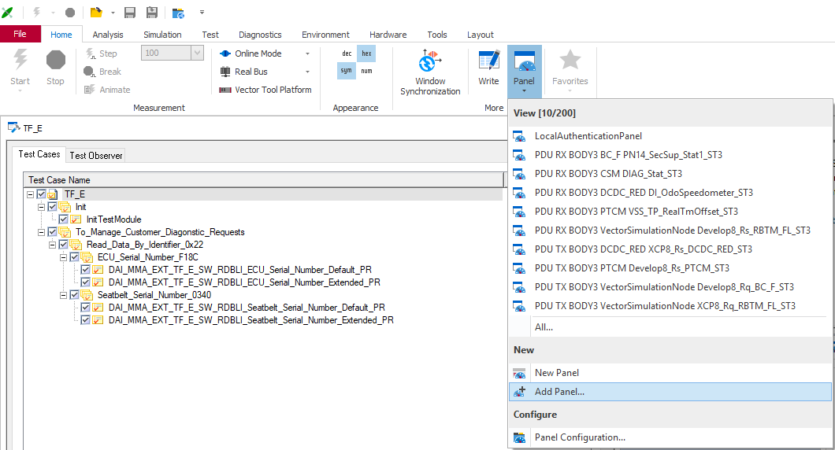
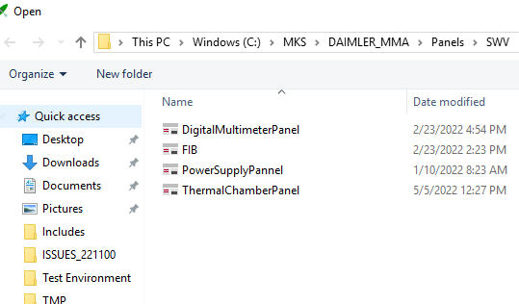
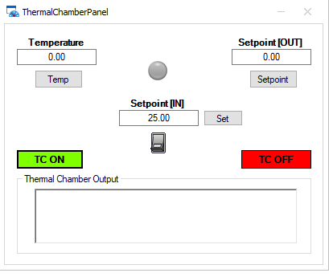
2.5 ThermalChamberPanel.xvp
Import to CANoe configuration: Home → Panel → Add Panel… → ThermalChamberPanel.xvp
After : 1. Temp button: reads the actual temperature from TMP;
2. Setpoint button: reads the actual setpoin;
3. Set button: will set the setpoint value from the box;
4. On/Off switch button: will read actual temperature in a ‘while loop’
(pay attention: set Off state if you want to select other button);
5. TC ON button: will start the TMP;
6. TC OFF button: will stop the TMP;
7. All info will be shown on ‘Thermal Chamber Output’.
1
2
4
3
4

Slide 11

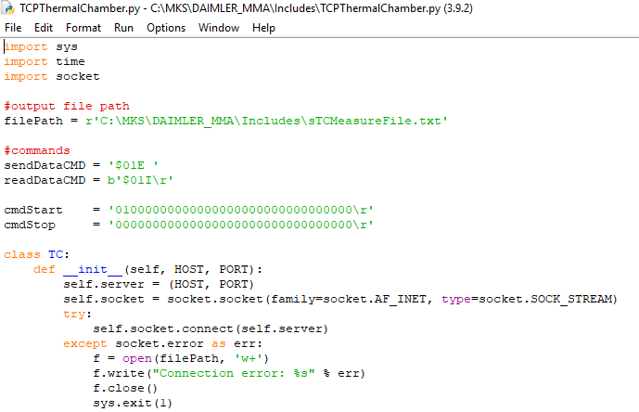
2.6 sTCMeasureFile.txt
sTCMeasureFile.txt is the TMP output file. This file can be created manually or *.py file will create this file automatically (modify the filePath as you need);
1
2

Slide 12

Saving More Lives

